Slide 1
Basic Data Analysis and PyCBC Tutorial with Google Colab​
Wei Ren Xu

Slide 2
Outline
Basic gravitational wave data analysis tutorial with Google Colab
What is Google Colab?
Basic operation of Google Colab
Gravitational Wave Open Science Center
LOSC tutorial
The strain data files
Power spectrum density
Whitening process
Power leakage
Matched filter
Basic PyCBC usage with Google Colab​
What is PyCBC?
Waveform generation
Taylor waveform
IMR waveform
EOB waveform

Slide 3
Basic Gravitational Wave Data Analysis with Google Colab​

Slide 4
What is Google Colab?
Google Colab is a free service provided by Google, it support jupyter-nobook IDE for Python.
Each computation node contain 2 Intel(R) Xeon(R) CPU and 2 K80 GPU.

Slide 5
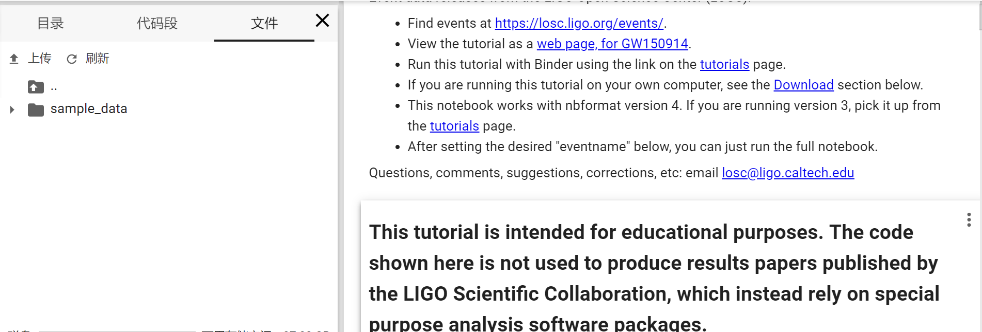
Basic operation of Google Colab
Upload files to virtual machine

Slide 6
Connect colab to your drive
!apt-get install -y -qq software-properties-common python-software-properties module-init-tools
!add-apt-repository -y ppa:alessandro-strada/ppa 2>&1 > /dev/null
!apt-get update -qq 2>&1 > /dev/null
!apt-get -y install -qq google-drive-ocamlfuse fuse
from google.colab import auth
auth.authenticate_user()
from oauth2client.client import GoogleCredentials
creds = GoogleCredentials.get_application_default()
import getpass
!google-drive-ocamlfuse -headless -id={creds.client_id} -secret={creds.client_secret} < /dev/null 2>&1 | grep URL
vcode = getpass.getpass()
!echo {vcode} | google-drive-ocamlfuse -headless -id={creds.client_id} -secret={creds.client_secret}
!mkdir -p Drive
!google-drive-ocamlfuse Drive

Slide 7
Gravitational Wave Open Science Center
https://www.gw-openscience.org/about/

Slide 8
LOSC tutorial
https://www.gw-openscience.org/GW150914data/LOSC_Event_tutorial_GW150914.html
Download the zip file, which contain all material about this tutorial.
Upload the files in folder ‘LOSC_Event_tutorial/ LOSC_Event_tutorial/’ to google colab.

Slide 9
The strain data files
H-H1_LOSC_4_V1-1167559920-32.hdf5
L-L1_LOSC_4_V2-1135136334-32.hdf5
The strain file contain a time series with 4096 sample rate. The length of the time series is 32 seconds.
In python, we use h5py library to read the hdf5 files.

Slide 10
Power spectrum density
The power spectrum density (PSD) describe the power of a time series in different frequency band.
Here we use python module matplotlib.pyplot.psd to calculate PSD. The module measure PSD via Welch’s method.
The Welch’s method: https://ieeexplore.ieee.org/document/1161901

Slide 11
Whitening process
In data analysis, we usually assume the noise is Gaussian and white, but in gravitational wave detector, the noise is color.
The whitening process divide the data by PSD in frequency domain, weighting the noise power in each frequency band.
$d_{w}\left(t\right)=\int_{−∞}^{∞}{\frac{\tilde{d}(f)}{\sqrt{S_{n}(f)}}e^{−2πift}df}$.

Slide 12
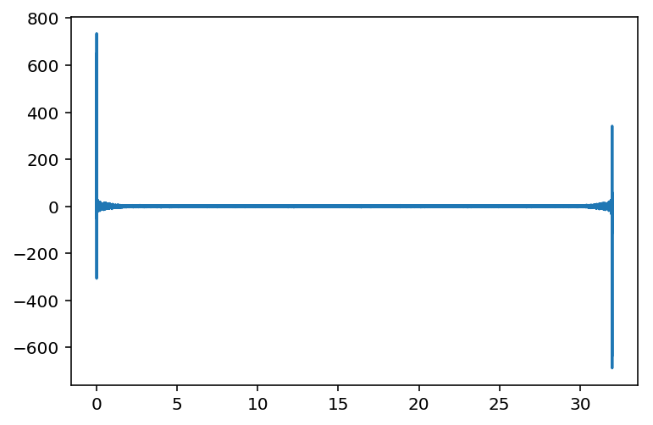
Power leakage
Because the stain data is not periodic, the Fourier transformation will cause a large amplitude at the beginning and the end of the transformed data, this phenomenon is called the power leakage.
There are two ways to solve this problem:
Apply window function on the transformed data.
Just cutting off the power leakage part.

Slide 13
Matched filter
Matched filter is a standard method to extract a known signal in a noisy background.
The matched filter process can be shown as follow
$$ρ=\int_{−∞}^{∞}{\frac{\tilde{d}(f){\tilde{h}}^{∗}(f)}{S_{n}(f)}}e^{2πift}df.$$
$\tilde{h}(f)$ is the template in frequency domain.

Slide 14
Basic PyCBC usage with Google Colab​

Slide 15
What is PyCBC?
PyCBC is a gravitational wave data analysis package maintained by LIGO. It contains algorithms that can detect coalescing compact binaries and do parameter estimation.
The PyCBC is not a default package of colab, you can install it on your colab with command as follow
import sys
!{sys.executable} -m pip install pycbc lalsuite ligo-common --no-cache-dir
https://pycbc.org/pycbc/latest/html/index.html

Slide 16
Waveform generation
As mentioned above, the matched filter need gravitational wave waveform template, the most accurate waveform can be generated by numerical relativity simulation, but it is very slow. So some waveform approximation method had been develop.
Here list three main approximation method
Taylor waveform
IMR waveform
EOB waveform

Slide 17
Taylor waveform
Taylor waveform expand small parameters, like velocity, to obtain an approximate solution of Einstein field equation which behave like Newtonian gravity (Post-Newtonian approximation).
The post-Newtonian approximation is under the assumption that gravity is weak, so it can only generate inspiral part.

Slide 18
IMR waveform
IMR waveform construct a phenomenological waveform in the Fourier domain, then fitting with a full inspiral-merge-ringdown waveform.
$u\left(f\right)=A_{eff}(f)e^{iΨ_{eff}(f)}$.
IMR waveform can generate whole gravitational wave waveform.
https://arxiv.org/abs/0704.3764v3

Slide 19
EOB waveform
EOB waveform mapping a binary system to a one test particle under a effective extra field system.
EOB waveform is thought to be the waveform that most close to numerical result.
Similar to IMR waveform, EOB waveform can also generate whole gravitational wave waveform.
https://arxiv.org/abs/gr-qc/9811091v1

Slide 20
Waveform generation
In PyCBC, you can generate the waveform via two modules
get_td_waveform for time domain waveform.
get_fd_waveform for frequency domain waveform.

